Slide 1
Flu Shot Learning: Predict H1N1 and Seasonal Flu Vaccines

Slide 2
01.
INTRODUCTION

Slide 3
Problem Statement
With infectious diseases spreading, the strain on the health care system can be excessive if the population does not accept the available vaccines to protect themselves and others.
Objective
U.S. Government is looking to build a model that will predict how likely the population is to take the H1N1 and Seasonal Flu vaccine.
The Data Set
To build this model, the data from the National 2009 H1N1 Flu Survey was used where there were 35 features available for each respondent of the survey. The features ranged from opinions on the diseases to socioeconomic characteristics such as Income, Race and Sex.
Notes:
Yashita

Slide 4
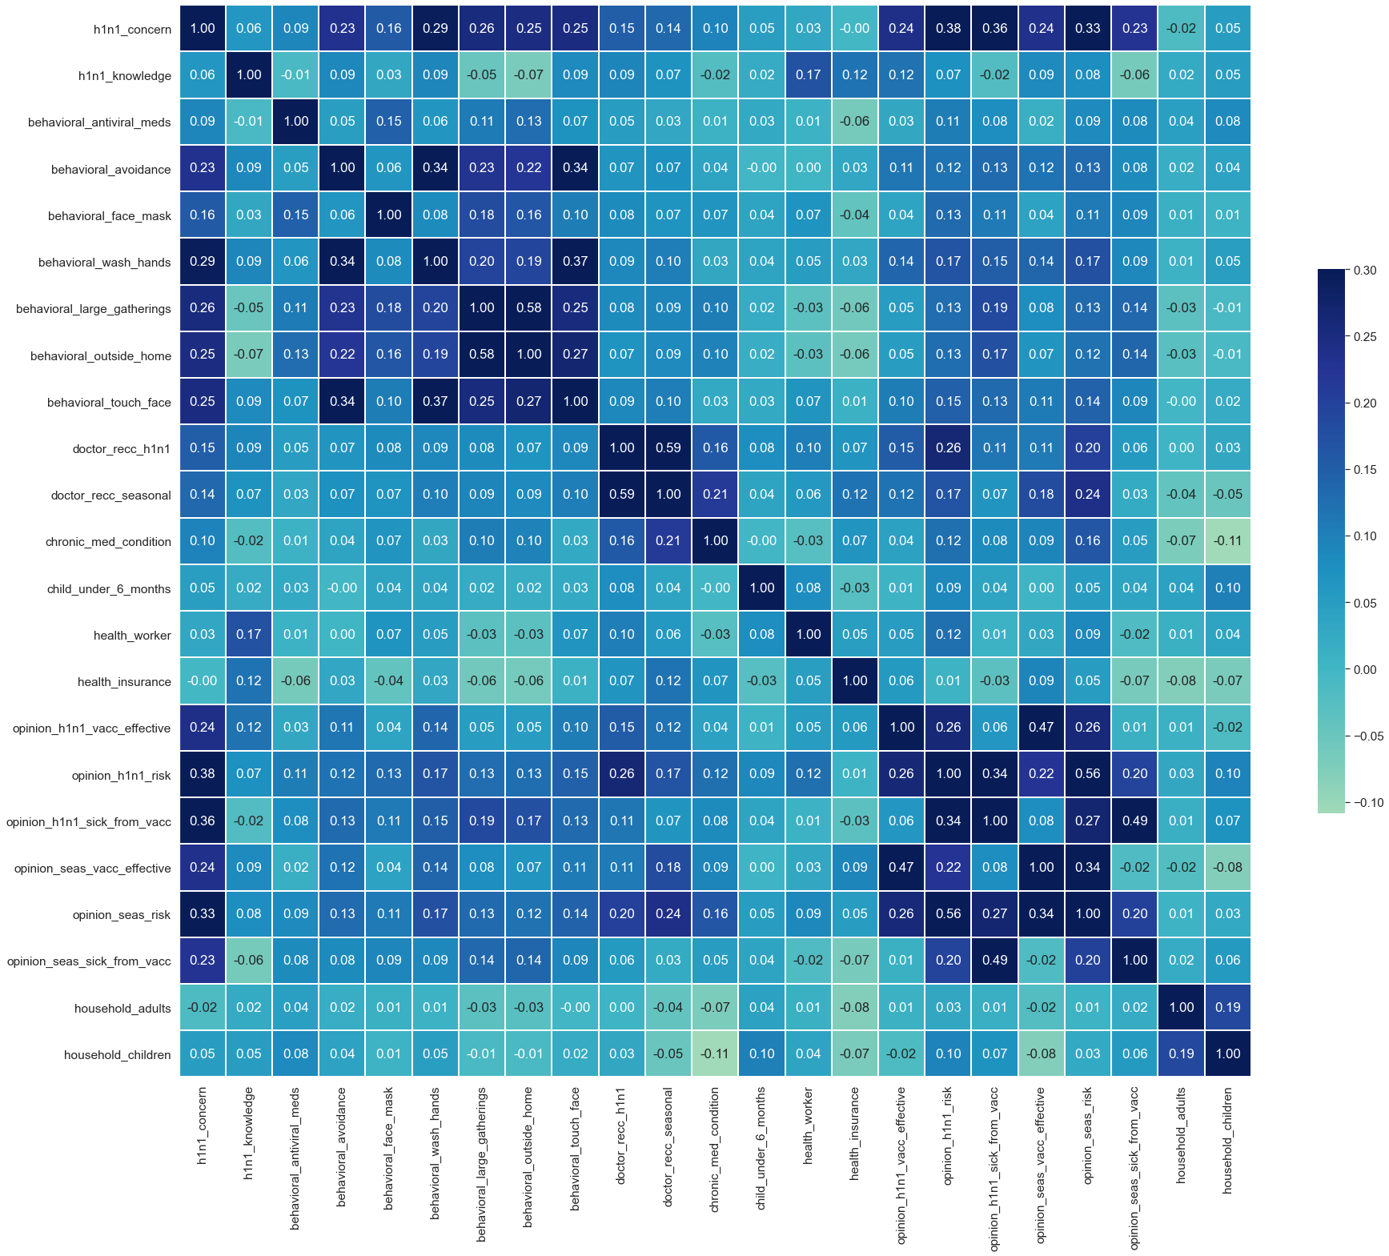
The Data Set – Correlation
Notes:
Yashita

Slide 5
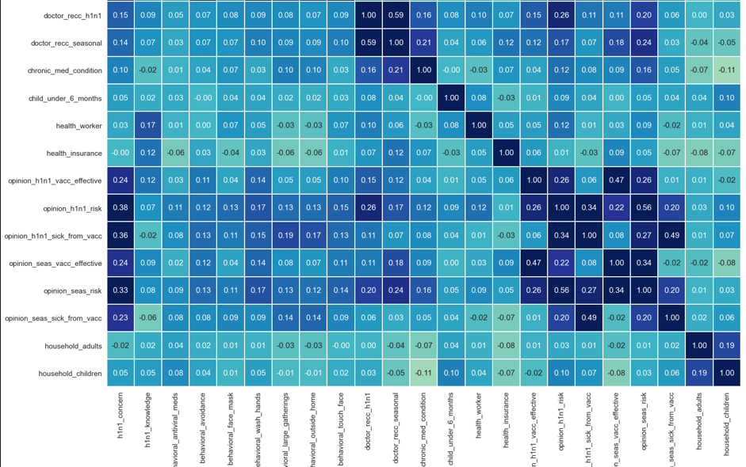

Slide 6
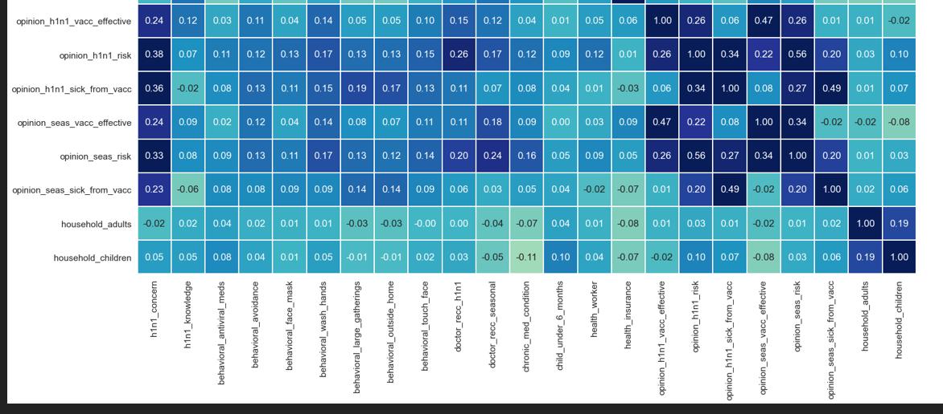

Slide 7
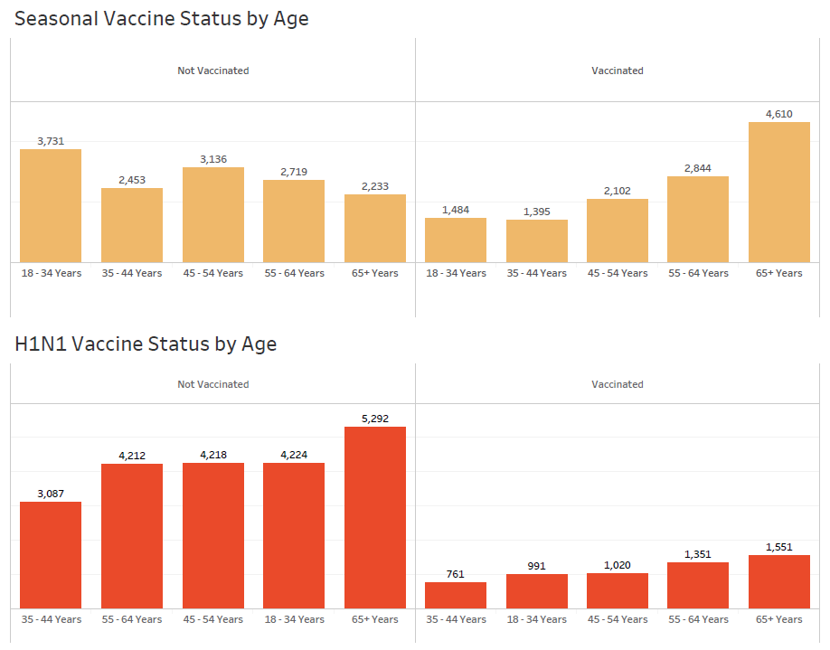
Does Age play a role in Vaccine Acceptance?
Notes:
Yashita

Slide 8
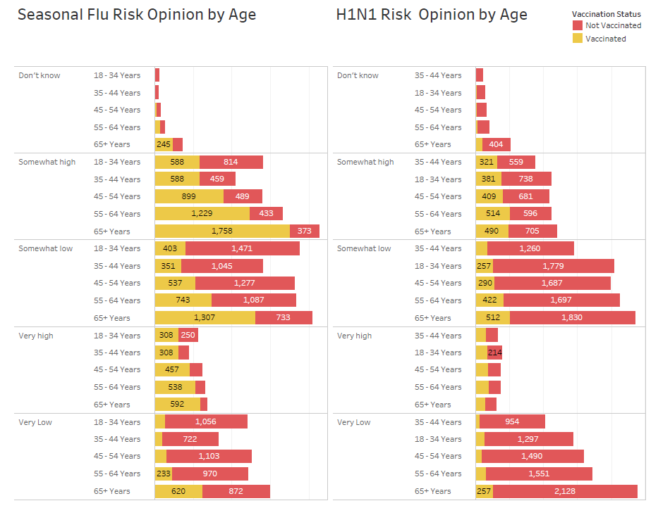
How Effective Is the Vaccine According to Respondents?
Notes:
Yashita

Slide 9
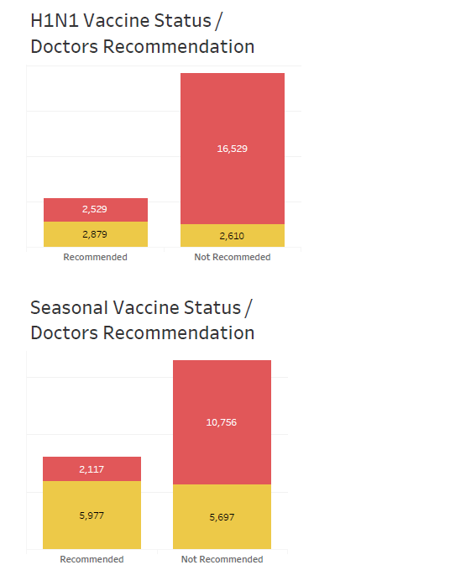
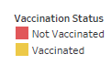
What Role Do Doctor’s Recommendations play in Promoting Vaccines?
Notes:
Yashita

Slide 10
02.
THE MODEL - EXPLAINED

Slide 11
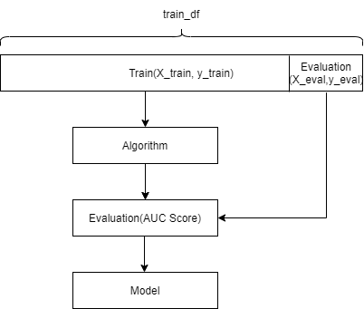
Overview
1
Import dataset
8
Preprocess on X_train, X_eval, train_df
9
Set algorithms and parameters
2
Check datatype
Check NA
7
Train/Test Split (test size=0.2)
10
3
Drop the columns[NA%>45%]
6
Define pipelines on two columns(simple imputer/ OHE)
11
Hyperparameters Tuning
4
Encode Data with different methods
5
Define numeric & non_numeric columns
12
Make predictions

Slide 12
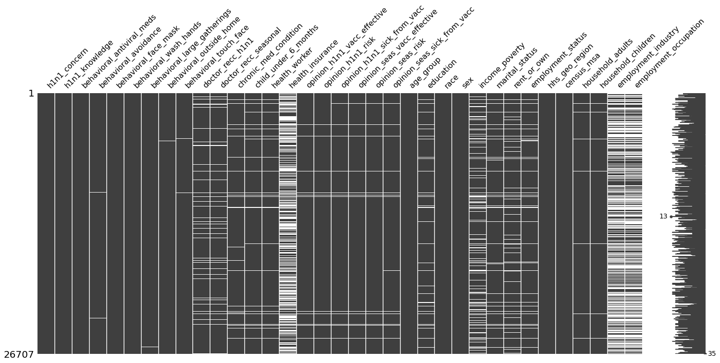
Pre-Process
Check NA
We drop the columns having more than 45% nan values.
health_insurance 45.96%
employment_industry 49.91%
employment_occupation 50.44%

Slide 13
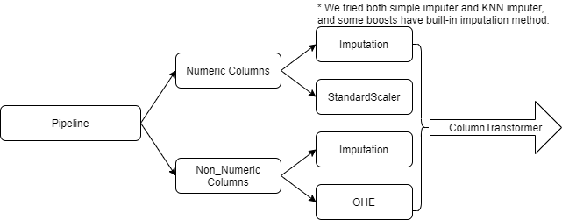
Pre-Process
Encoding
Label Encoding | rent_or_own | "Own"=1; rest=0
 | employment_status | "Employed"=1; rest=0
 | marital_status | "Married"=1, rest=0
 | census_msa | "MSA, Principal City" =1, rest =0
Ordinal Encoding | income_poverty | 'Below Poverty':1, '<= $75,000, Above Poverty':2, '> $75,000':3
 | age_group | '18 - 34 Years':1, '35 - 44 Years':2, '45 - 54 Years':3, '55 - 64 Years':4,'65+ Years':5
 | education | '< 12 Years':1, '12 Years':2, 'Some College':3, 'College Graduate':4
One-Hot Encoding | race | creates 4 new columns (used in pipeline)
 | sex | creates 2 new columns (used in pipeline)
 | hhs_geo_region | creates 10 new columns (used in pipeline)
Pipeline
X_train_preprocess, X_eval_preprocess (45 features)

Slide 14
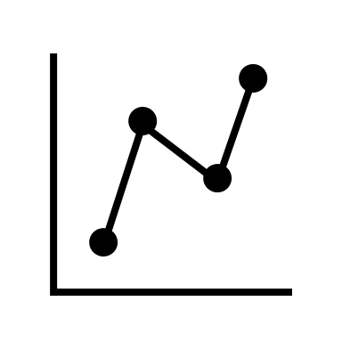
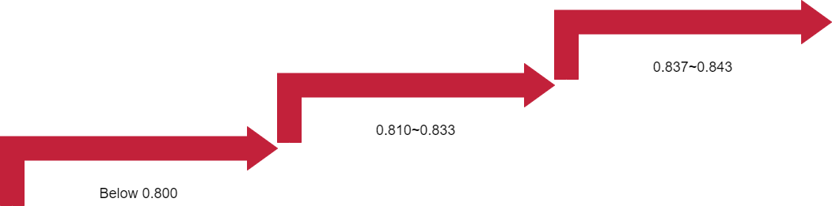
Model Improvements
Method/Algorithm | AUC
XGboost_Simple Imputer _Optuna | 0.8425
LightGBM_Simple imputer | 0.8417
Catboost_built_in imputer | 0.8414
LightGBM_Simple imputer | 0.8400
XGBoost | 0.8397
CatBoost _ Randomized Search | 0.8378
HistGradientBoosting _ Randomized Search | 0.8373
HistGradientBoosting _ GridSearch | 0.8368
Method/Algorithm | AUC
Random Forest _ KNN Imputer | 0.8335
Catboost_Optuna_ KNN Imputation | 0.8326
Random Forest with Hyperparameter Tuning | 0.8315
LogesticRegression_Simpleimputer | 0.8278
LogesticRegression_KNNimputer | 0.8266
Ensembles - KNN, SVM, DT, RF, NN, Catboost - SimpleImputations | 0.8161
Ensembles - KNN, SVM, DT, RF, NN - KNN Imputations | 0.8148
Method/Algorithm | AUC
Random Forest _Simpleimputer | 0.7784
Gradient Boosting _Simple Imputer | 0.7768
Extra Trees_Simple Imputer | 0.7758
Random Forest_ Simpleimputer | 0.7299
Decision Tree_Simpleimputer | 0.6721
Neural Networks_Randomized Search | 0.6246
Notes:
Michelle

Slide 15








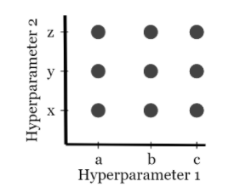
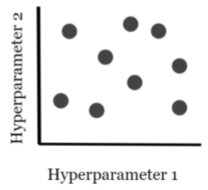
Phases of Improvement
Done!
Accuracy: 0.6, 0.7
Done!
Accuracy: 0.7
Done!
Accuracy: 0.4
Let me try a random model
How about Neural Networks? Or Decision Trees? Or Logistic Regression?
Let me manually fidget with parameter
Max_depth : 4
Max_leaf_nodes : 12
Let me manually again fidget with parameter
Max_depth : 8
Max_leaf_nodes : 21
Done!
Accuracy:
0.8425, 0.8417, 0.8413, 0.8400
Done!
Accuracy: 0.81, 0.82
Done!
Accuracy: 0.82
Let me try to use GridSearch/RandomSearch Hypertuning
How about making a cocktail of different models (Ensembles)?
Stacking : KNN, SV, DT, RF, Catboost
Voting : KNN, SVM, DT, RF, Catboost
Uncle Steve mentioned, “Boosting is your friend”
Sure! Why not?
XgBoost
Catboost
LGBM
HistGradient Boosting
Notes:
Siddharth/Talal

Slide 16
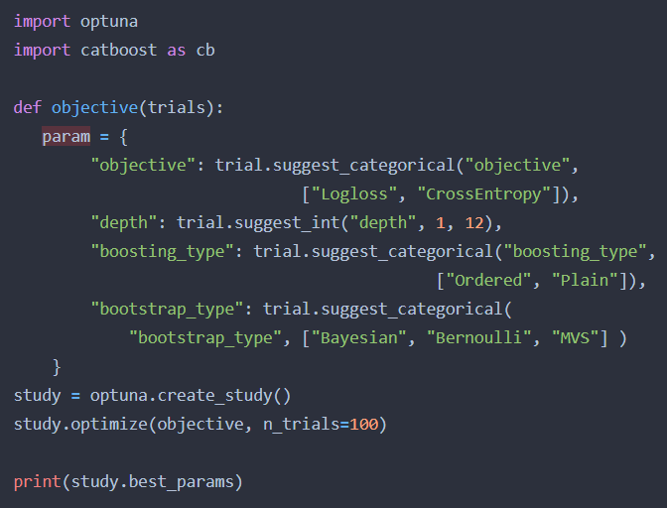
Optuna – Hyperparameter Optimization Framework
Optimization Strategy
Sampling
Random Search
Grid Search
Gaussian
TPE
User Defined Sampler
Pruning
Successive Halving
Notes:
Siddharth/Talal

Slide 17

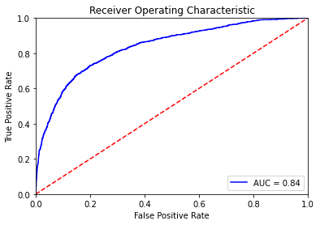

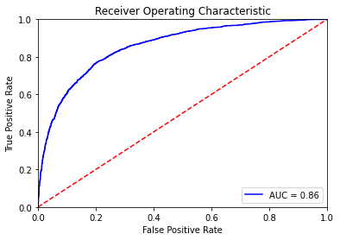
Best Model
H1N1
Seasonal Flu

Slide 18
Confusion Matrix
Confusion Matrix
4042 | 165
495 | 640
2551 | 303
375 | 2113
Confusion Matrix
F1 Score
0-
0-
Actuals
Actuals
1-
1-
-
-
-
-
0
1
0
1
Predictions
Predictions
H1N1
Accuracy | 0.88
Precision | 0.56
Recall | 0.80
F1-Score | 0.66
Seasonal Flu
Accuracy | 0.87
Precision | 0.87
Recall | 0.85
F1-Score | 0.86

Slide 19
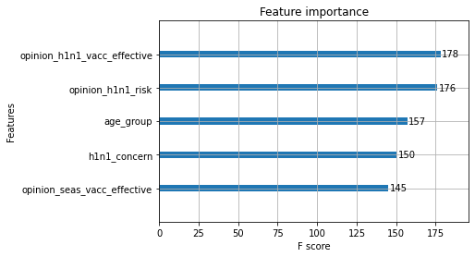
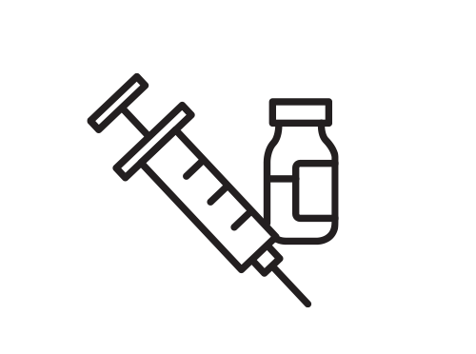
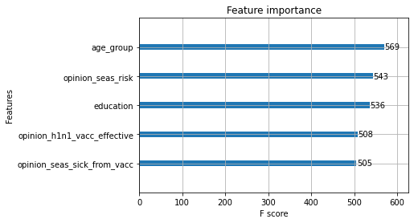
Feature Importance
H1N1
Seasonal Flu

Slide 20
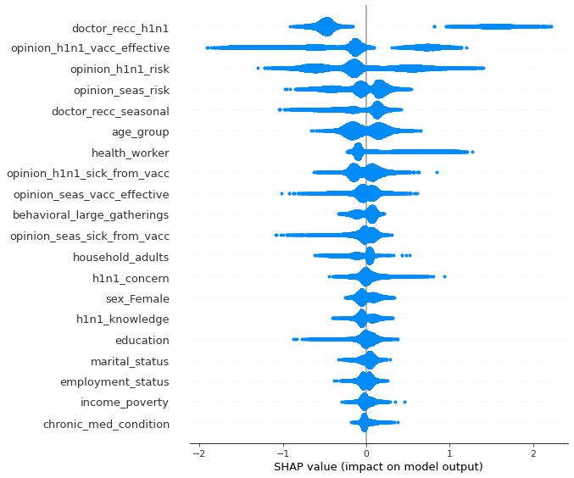
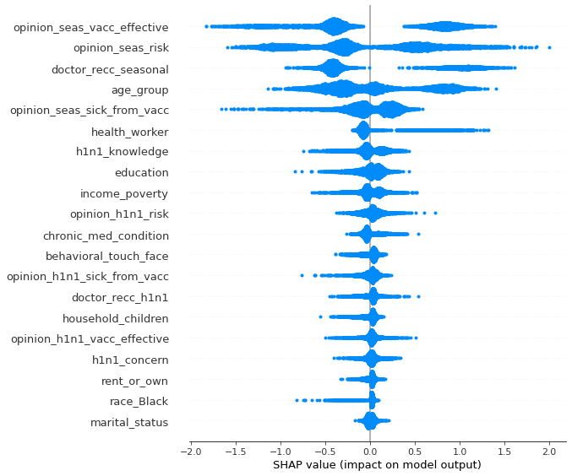
SHAP Value
H1N1
Seasonal Flu
Notes:
There is a big difference between both importance measures: Permutation feature importance is based on the decrease in model performance. SHAP is based on magnitude of feature attributions. The feature importance plot is useful, but contains no information beyond the importances.

Slide 21
03.
THE MODEL UTILITY & FINDINGS

Slide 22

Cost Comparison - H1N1
Without predictive model (every 1M population):
Confusion Matrix
Cost matrix
Assumed infect probability
75.66% | 3.09%
9.27% | 11.98%
$3,000
$0
1%
0%
$2,362,500,000
$0
0-
Actuals
x
(
)
$2,362,500,000
=
1-
-
-
0
1
Predictions
With predictive model (every 1M population):
$2,342,194,500
Every 1M population
Confusion Matrix
Cost matrix
Assumed infect probability
75.66% | 3.09%
9.27% | 11.98%
TN $25 | FP $3,000
FN $5 | TP $0
0% | 1%
0% | 0%
TN $18,915,000 | FP $927,000
FN $463,500 | TP $0
0-
Actuals
x
(
)
=
$20,305,500
1-
-
-
0
1
Predictions

Slide 23
Cost Comparison – Seasonal Flu
Without predictive model (every 1M population):
Confusion Matrix
Cost matrix
Assumed infect probability
47.75% | 5.67%
7.02% | 39.56%
$760
$0
50%
0%
$202,996,000
$0
0-
Actuals
x
(
)
$202,996,000
=
1-
-
-
0
1
Predictions
With predictive model (every 1M population):
$169,161,500
Every 1M population
Confusion Matrix
Cost matrix
Assumed infect probability
47.75% | 5.67%
7.02% | 39.56%
TN $25 | FP $760
FN $5 | TP $0
0% | 50%
0% | 0%
TN $11,937,500 | FP $21,546,000
FN $351,000 | TP $0
0-
Actuals
x
(
)
=
$33,834,500
1-
-
-
0
1
Predictions

Slide 24

Lives Savings
H1N1
Seasonal flu
Without predictive model:
Without predictive model:
1M*0.0079%=79
0
1M*0.003%=30
0
0-
0-
Actuals
Actuals
1-
1-
With predict model:
With predict model:
Save 76 lives every 1M population
Save 27 lives every 1M population
0 | 1M*0.0003%=3
0 | 0
0 | 1M*0.0003%=3
0 | 0
0-
0-
Actuals
Actuals
1-
1-
-
-
-
-
0
1
0
Predictions
1
Predictions
Notes:
1% infected > 1% death = 0.0001 = 0.01%
50% > 0.01% = 0.00005 = 0.005%
0.01%*(75.66%+3.09%) ~ 0.0079%
0.01%*3.09% ~ 0.0003%
0.005%*(47.75%+5.67%) ~ 0.003%
0.005%*5.67% ~ 0.0003%
every 1M population

Slide 25
Comparison Summary
Every 1M population | Without predictive model | With predictive model | Saved
H1N1- Cost | $2,362,500,000 | $20,305,500 | $2,342,194,500
H1N1- Lives savings | 79 | 3 | 76
Seasonal Flu - Cost | $202,996,000 | $33,834,500 | $169,161,500
Seasonal Flu- Lives savings | 30 | 3 | 27

Slide 26
04.
RECOMMENDATIONS

Slide 27
The Model Says...
The Model Says...
Feature importance shows Age as a significant feature
Younger age groups are less likely to get vaccinated
Younger age groups are less likely to see flu as a risk
Younger age groups are also more likely to go out
Feature importance shows Doctors Advice impacts the opinion of respondents
People with doctors advice are more likely to get a shot
Age Group
Doctor's Recommendation
The Government Should...
The Government Should...
Ask doctors to recommend patients to get vaccines
Invest in doctor's awareness programs to effectively communicate in masses the importance of getting vaccinated
Provide basic quantites of vaccines to doctors FOC
Open more accessible on sites with a doctor
Run awareness campaigns in collaboration with scchool/college board before each season the virus spreads
Run campaigns in high viral seasons between podcasts, on Spotify, Facebook, Instagram and Apple Music
Ask doctors to check all people between the age of 15 to 30 if they have recieved flu shots, on every medical visit
Notes:
Zain

Slide 28
The Model Says...
Individual belonging to black race are less likely to get vaccinated
The Model Says...
Race
The Government Should...
The model can save costs in billions
This does not account economic costs of people falling sick and not going to work, stores being closed, unemployment benefits, etc
Adding them will boost the cost further up
Run radio/SMS ads in location with higher density of black population
Invest in celebrity endorsement (Will Smith/Oprah Winfrey, etc)
Financials
The Model Says...
The Government Should...
Falling Sick
People who rate higher on having an opinion of falling sick due to vaccine, are less likely to get one
Invest in the Model. Of course
The Government Should...
Run awareness campaign that falling sick is normal
Insure any health related issues post vaccine shot for 48 hours
Notes:
Zain

Slide 29

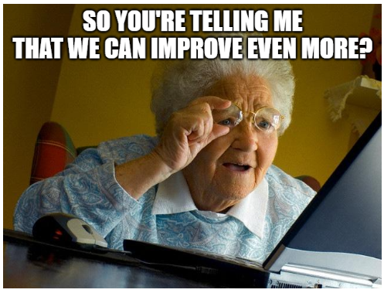
Future Work
More Hypertuning
More Trials
More ensemble techniques with better hypertuned models
Better pre-processing techniques like :
Balancing data based on target variables
Encoding each features differently using techniques like one hot encoding, label encoding or binning
Feature scalling (if necessary)
More feature engineering (create more features based on existing features)
Try more optimization frameworks like Optuna with different models
Notes:
Siddharth

Slide 30

Learnings
Familiarize yourself with the data very well before building the model.
Adding more hyperparameters does not improve the accuracy. Quality > Quantity.
Sometimes simple models can provide better results than the complex ones.
There's not one best model, but there's one right for the business context.
Pipeline is a smart tool and can help automate machine learning workflows.
Be brave, data science knowledge is evolving constantly, and as our approach should too.
Notes:
Appreciate the course and the professor
Familiarize yourself better with the data before running the model
Sometimes simple models could provide better results than the complex ones
Add more Hyperparameters does not improve the accuracy. Quality > Quantity
There's not one best model, but there's one right for your dataset
Pipeline is a smart tool and can help automate machine learning workflows.
There are many built - in visualization functions in the boost algorithm.
You must have some reasons to encode the categorical variables and select the most reasonalble one.
Find a baseline when you started.

Slide 31
“Some people call this artificial intelligence, but the reality is this technology will enhance us. So instead of artificial intelligence, I think we’ll augment our intelligence.”
- Ginni Rometty (Former CEO of IBM)

Slide 32
Appendix
Team Goodwin

Slide 33
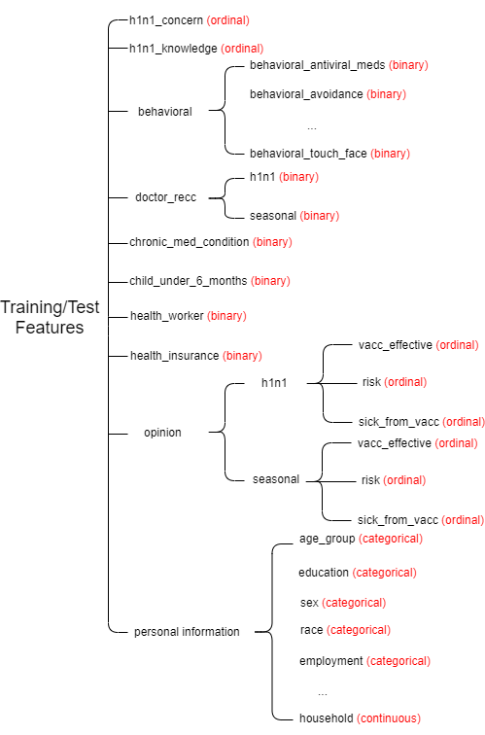
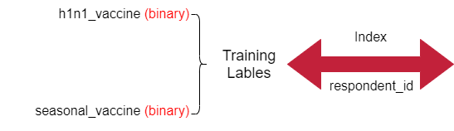
DATA DESCRIPTION
35 feature columns in total
2 target variables

Slide 34
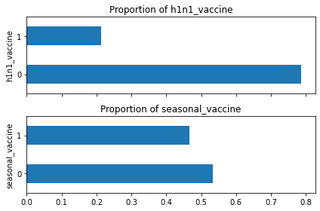
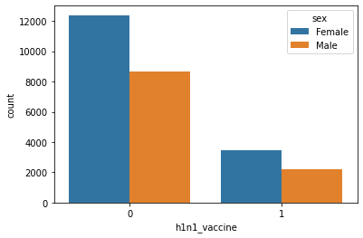
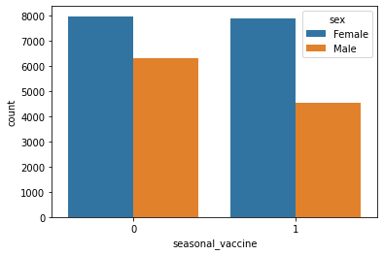
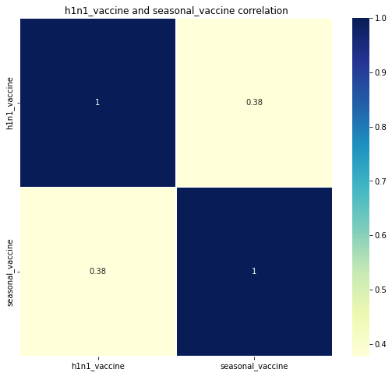
EXPLORATORY DATA ANALYSIS
Notes:
Nearly 50% of the people received seasonal flu vaccine; 20% of the people received H1N1 flu vaccine. we can stated that H1N1 has moderately imbalanced data (Confusion Matrix, F1 score needed)
[Lightly touch on Sid’s attempt to tackle with the data imbalance]
From the above figure we can conclude that a higher number of people have taken seasonal vaccine irrespective of sex but interesting to note there is a higher number of females who took both vaccines
We are going to study with the respondents’ demographic characterises to suggest us government to take actions on different ppl.

Slide 35
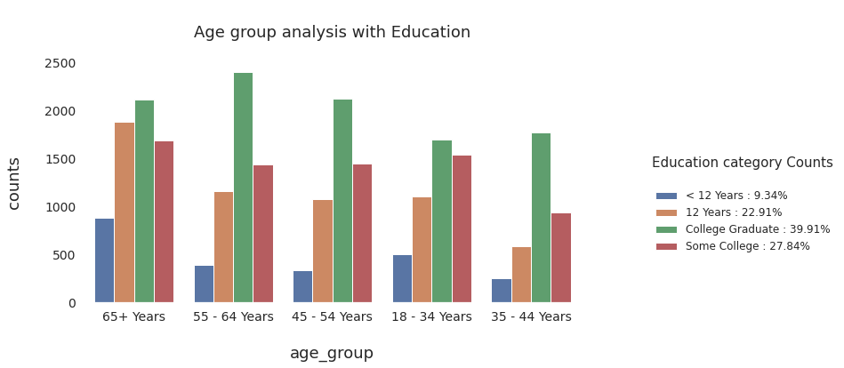
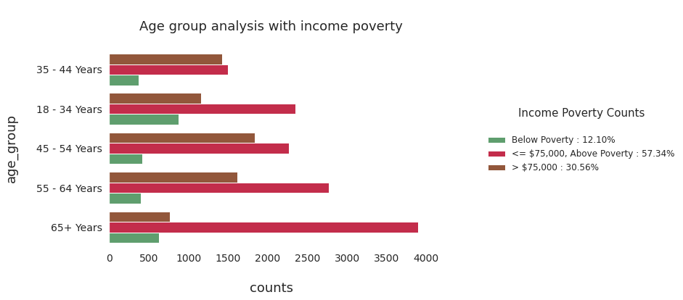
Most respondents are college graduates or have some college.
Only 12% respondents’ income situations are below poverty.

Slide 36
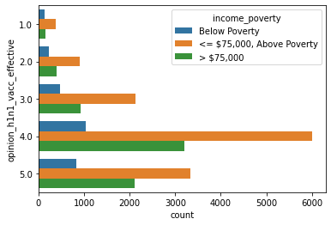
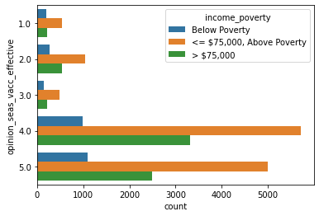
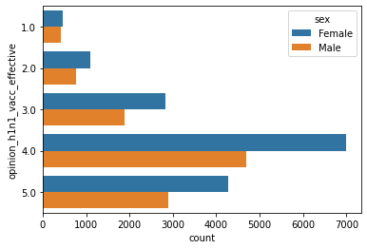
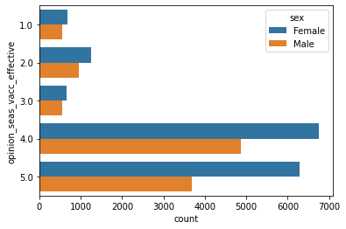
Notes:
Most respondents believe both h1n1 and seasonal flu vaccine are effective. However we can see more ppl have common sense that seasonal flu are effective compare h1n1.
Relationship between opinion and vaccination

Slide 37
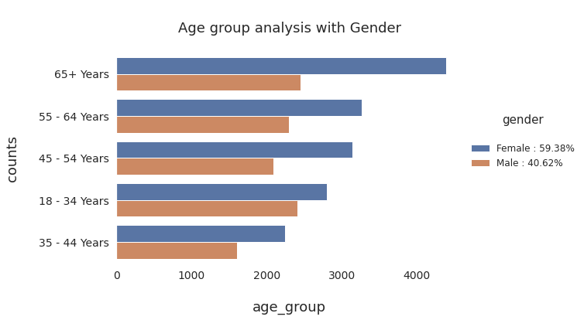

Slide 38
What Impacted Improvement?
Major
Boosting
Hyperparameter Tuning
Average
Imputation
Data Balancing
Minor
Ensembles
Scaling
Notes:
Siddharth/Talal

Slide 39
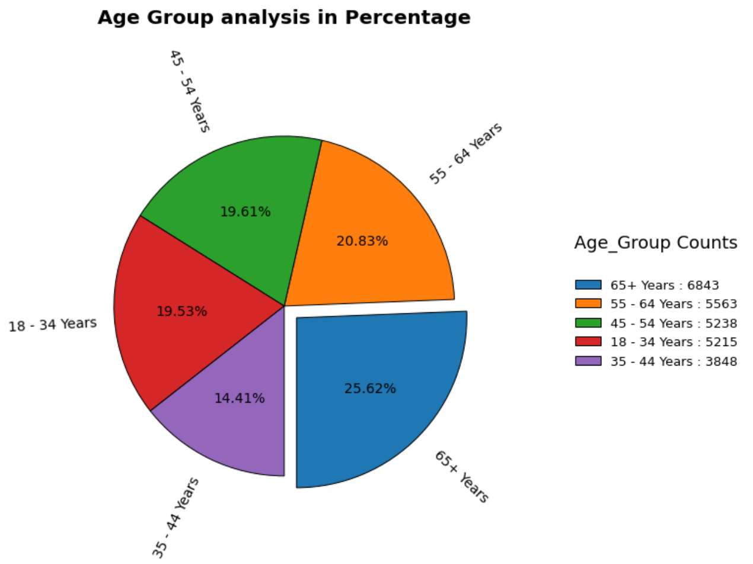
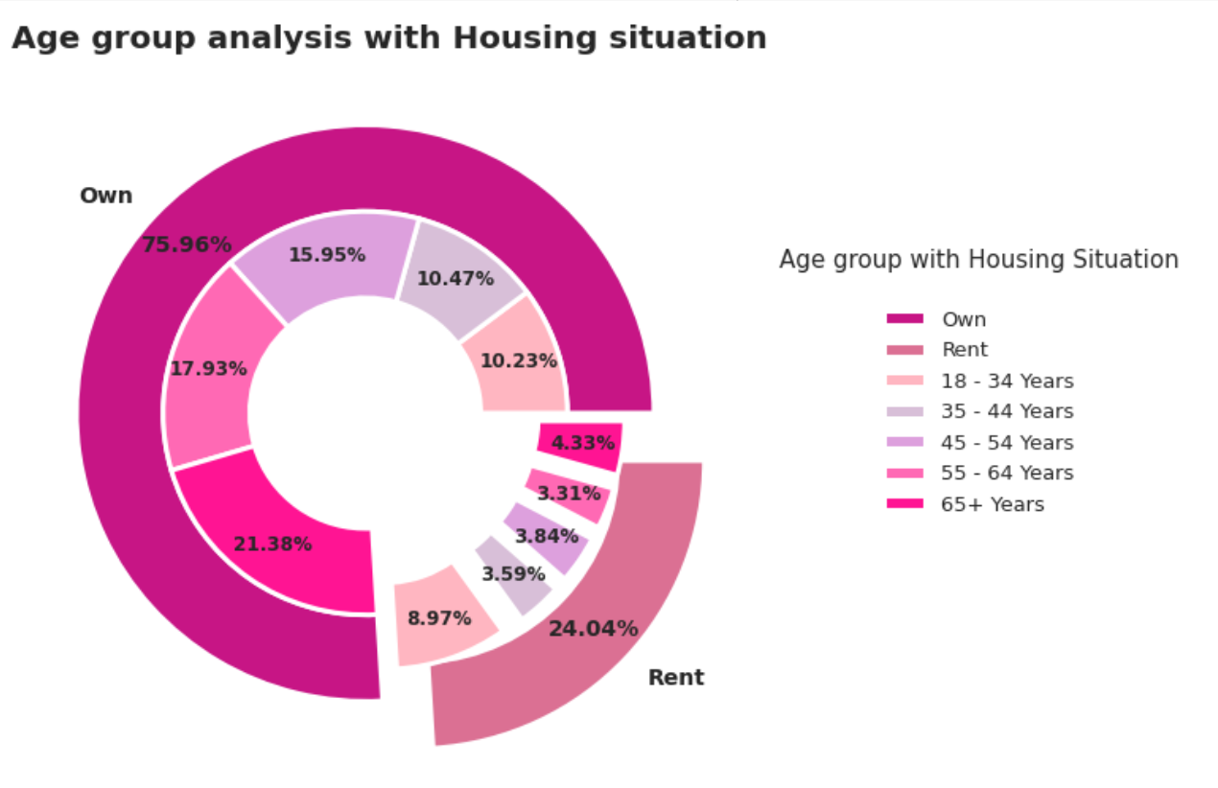
The dataset consists of a relatively older age group more in number compared to young age people.
75.96% own a house while 24.014% are the remainder who rent.
Notes:
Question? These can only show the demographic but we need to find the possible factors or facts that can drive ppl to take or not take flu vaccine?
1. 65+ age group person has a higher count than 55-64 age group in number.35-44 year age group has the least count in given dataset
2. People who own a house, 21.38% people are from 65+ year age group which represents a significant amount while 10.23% are from 18-34 years age group which is quite low in number. people who rent, 8.97% people belong from 18-34 years age group which is high in number while 3.31% people belong from 55-64 years (But this graph can tell why we took “Own” as 1 when we did data prepossessing)

Slide 40
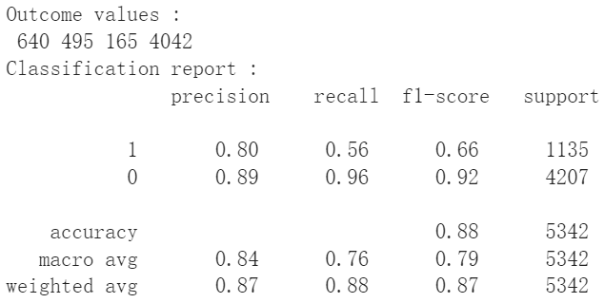
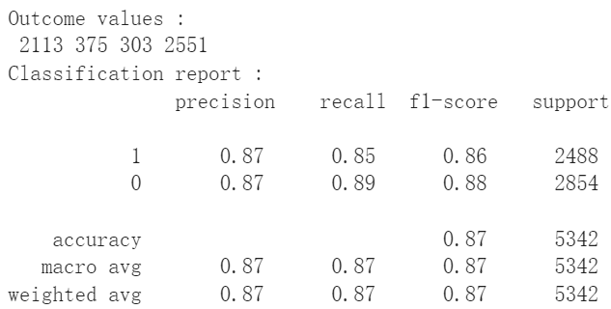
Classifier Report
Notes:
Change the report into table?

Slide 41
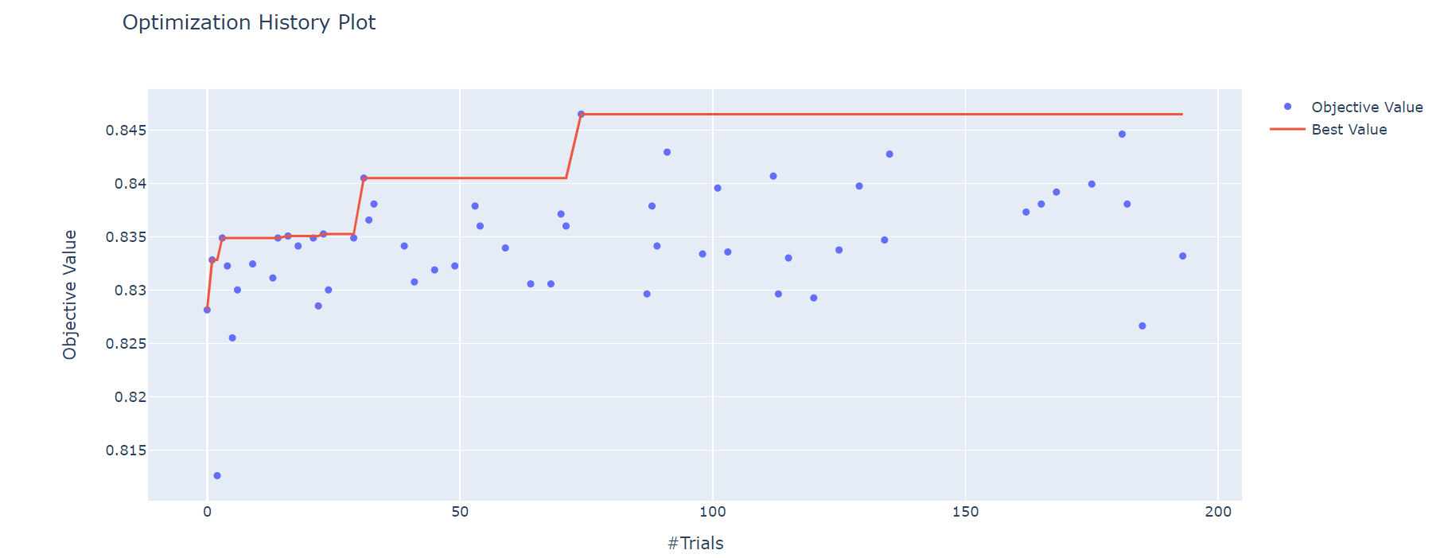
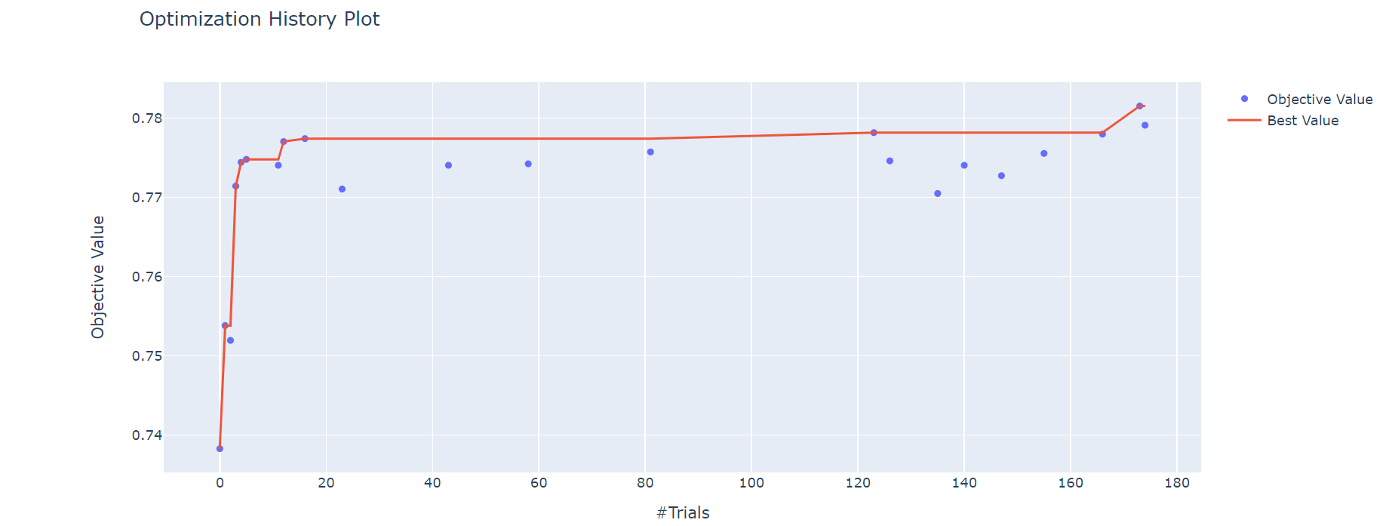
Optimization History Plot – Optuna

Slide 42
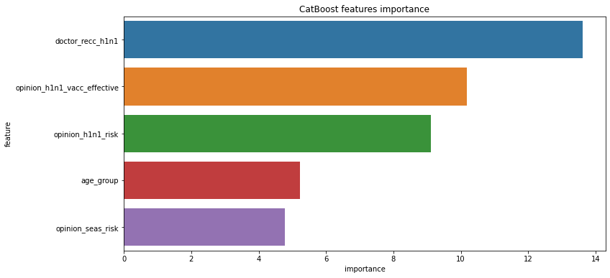
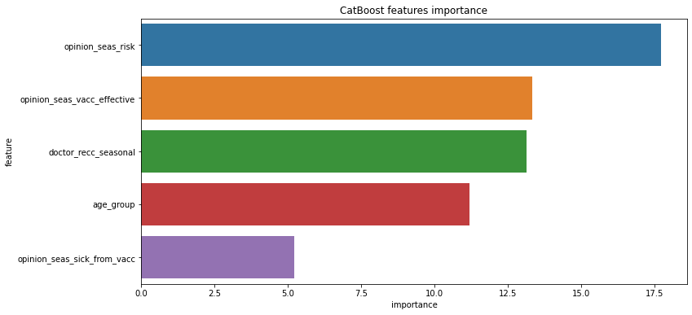
Feature Importance From Catboost
H1N1
Seasonal Flu

Slide 43
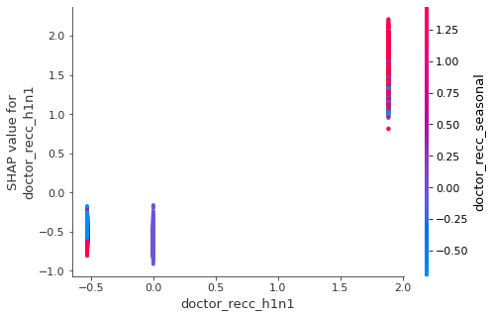
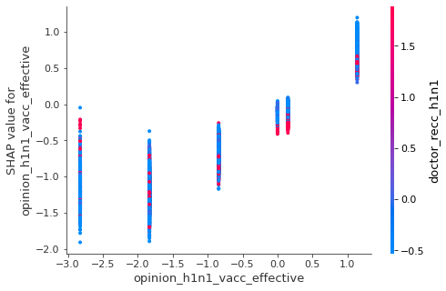
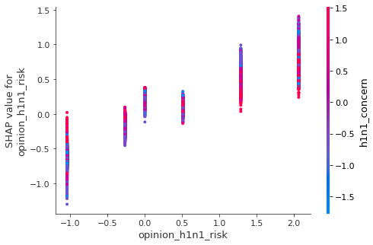
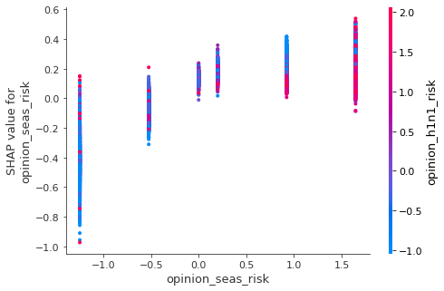
SHAP Value-h1n1 model

Slide 44
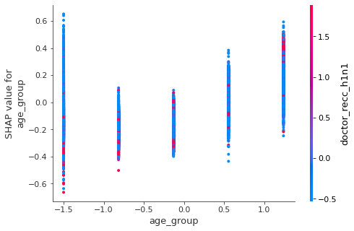
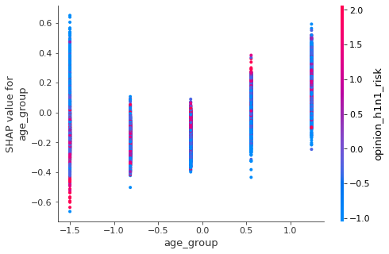
SHAP Value-h1n1 model

Slide 45




SHAP Value-seasonal flu model

Slide 46


SHAP Value-seasonal flu model

Slide 47
Our Recommendations
H1N1 Vaccination
Seasonal Flu Vaccination
Advice doctors and authorities to promote the h1n1 effectiveness.
Public health department can launch a survey on what aspects of risks people concern about h1n1 vaccination.
Authorities should clarify the risk of h1n1 vaccines during mass communication.
Open more accessible on-site seasonal flu vaccination spots in small and suburban areas.
Educate the public how to handle with the situations if you get sick after vaccinated.
Clarify the detail instructions for different age group especially the old and the youth.
Publicize the significance of flu vaccination during flu season.
Public health department can organize the professional seminars to invite doctors share thoughts on seasonal flu vaccination risk and effectiveness.
Notes:
Need to replenish
High density area
Recommendations to US government

Slide 48
Application
Targeted campaigns to educate
Provide incentives to get vaccinated
Have an advocate in local communities
Notes:
https://time.com/5951755/how-to-convince-people-to-get-vaccinated/

